Slide 1

IT & DA Monthly Team Meeting
January 2021

Slide 2
Agenda
Announcements
Aerozona Obiadazie
IT & DA Audit Plan
Lynn Atkin
IA Department and Individual goals
Ron Roy
Goal Setting Walkthrough
Eric Baba
Upcoming Events
Open Forum

Slide 3

Announcements

Slide 4



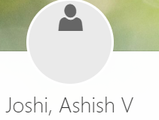
New Team Members

Slide 5
BIRTHDAYS
Oquendo, Luz ~ January 3rd
Colville, Matthew ~ January 6th

Slide 6
IT & DA Audit Plan

Slide 7
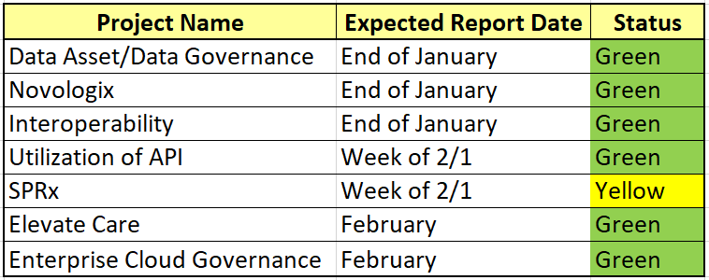
IT & DA Audit Plan
7
©2020 CVS Health and/or one of its affiliates. Confidential and proprietary.

Slide 8
IA Department and Individual goals

Slide 9
Internal Audit 2021 Goals
Collaborate with key stakeholders including audit committee, management, and external auditors to build a strong internal control environment and ensure that we meet our audit plan commitments
Develop a transparent and standardized reporting for internal audit purposes and our business partners with regular updates including:
Monthly Utilization
Monthly Operations Audit plan vs. Forecast update
Weekly SOX testing progress report vs Forecast update
Monthly Audit Operations and SOX issues update reports sent to business partners
Develop simple and standardized reporting packages for audit committee meetings with regular communications to presenters
Develop an audit universe which covers the full spectrum of each business segments major risks and activities
Refine risk identification and assessment capabilities to enhance risk-based auditing which meets organizational priorities.
Create a streamlined audit reporting process to reduce the report review and approval times
Develop metrics to be utilized both internal management and reporting to the audit committee
Attract and retain skilled and diverse talent to meet the demands and complexity of our businesses
Invest in talent development to enable execution of operational and SOX audits
Advance employee engagement through targeted opportunities for growth
Leverage AuditBoard and its connected digital ecosystem to improve efficiencies and provide a superior end-to-end audit experience to our customers
Drive increase in quality and efficiency through use of automation, digitization and data analytics technologies and processes for each team

Slide 10
Internal Audit 2021 Goals
Collaborate with key stakeholders including audit committee, management, and external auditors to build a strong internal control environment and ensure that we meet our audit plan commitments
Develop a transparent and standardized reporting for internal audit purposes and our business partners with regular updates including:
Monthly Utilization
Monthly Operations Audit plan vs. Forecast update
Weekly SOX testing progress report vs Forecast update
Monthly Audit Operations and SOX issues update reports sent to business partners
Develop simple and standardized reporting packages for audit committee meetings with regular communications to presenters
Develop an audit universe which covers the full spectrum of each business segments major risks and activities
Refine risk identification and assessment capabilities to enhance risk-based auditing which meets organizational priorities.
Create a streamlined audit reporting process to reduce the report review and approval times
Develop metrics to be utilized both internal management and reporting to the audit committee
Attract and retain skilled and diverse talent to meet the demands and complexity of our businesses
Invest in talent development to enable execution of operational and SOX audits
Advance employee engagement through targeted opportunities for growth
Leverage AuditBoard and its connected digital ecosystem to improve efficiencies and provide a superior end-to-end audit experience to our customers
Drive increase in quality and efficiency through use of automation, digitization and data analytics technologies and processes for each team

Slide 11
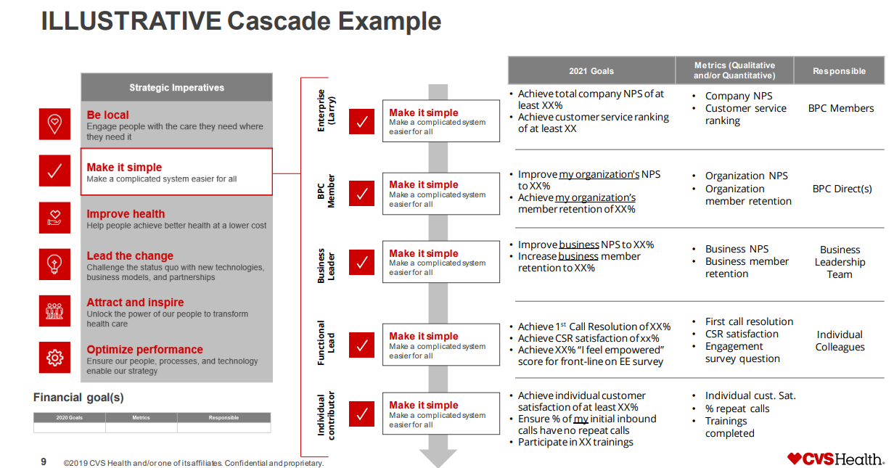

Slide 12
Cascade Example
 | 2021 Goals | Metrics
CAE | Develop metrics to be utilized for internal management and reporting to the audit committee. | Management reporting both internal and audit committee.
CAE Direct | Develop IT Audit metrics to be utilized for internal management and reporting to the audit committee. | IT Audit reports for both internal and audit committee.
Director | Align AuditBoard IT Audit metrics to support the design for internal management and reporting to the audit committee. | IT Audit reports for both internal and audit committee.
Manager | Ensure assigned IT Audit Project status and details are kept current and accurate for management reporting. Ensure assigned IT Audit Project hours are accurate which are then used in management reporting. | Monitor AuditBoard dashboard and timesheets. Weekly review customized views in AB to ensure key reporting fields are current.
APM / Supervisor | Ensure assigned IT Audit Project status and details are kept current and accurate for management reporting. Ensure assigned IT Audit Project hours are accurate which are then used in management reporting. | Weekly review customized views in AB to ensure key reporting fields are current. Review personal AB view to ensure hours are current.
Senior Consultant | Ensure individual hours are booked each reporting period. | Review personal AB view to ensure hours are current.
Consultant | Ensure individual hours are booked each reporting period. | Review personal AB view to ensure hours are current.

Slide 13
Goal Setting Walkthrough

Slide 14
Upcoming Events

Slide 15

Monthly Meetings
February
Eric Mata (RI)
March
Konrad Wisniewski (CT)

Slide 16
Open Forum

Slide 17
Open Forum

